Slide 1
Some Discrete Probability Distributions
Chapter 5

Slide 2
Chapter 5
You may have noticed in chapter 3 that certain random variables looked the same for different experiments. For instance, counting the number of heads in three flips of a coin ended up having the same probability distribution as counting the number of red chips when three chips were drawn with replacement from a jar containing 2 red and 2 black chips.
Because many experiments will end up having the same probability distribution, it is helpful to know and be able to use the more common distributions.

Slide 3
Chapter 5
Chapters 5 and 6 will cover some specific discrete and continuous probability distributions, respectively.
In chapter 5, we will discuss the Binomial and Multinomial distributions in 5.2. Then we will cover the Poisson distribution in 5.5. The sections in between go over some other common distributions, but Binomial and Poisson are probably the most commonly used discrete distributions.

Slide 4
5.2 – Binomial and Multinomial
We are often concerned with experiments that have only two possible outcomes. We can arbitrarily label one outcome as a success and one outcome as a failure. Some examples:
  Kicking a field goal in football
  Disease screening
  Vaccine/medication effectiveness
  Seed germination
  Opinion polling (such as approval ratings)
  Pesticide/herbicide effectiveness

Slide 5
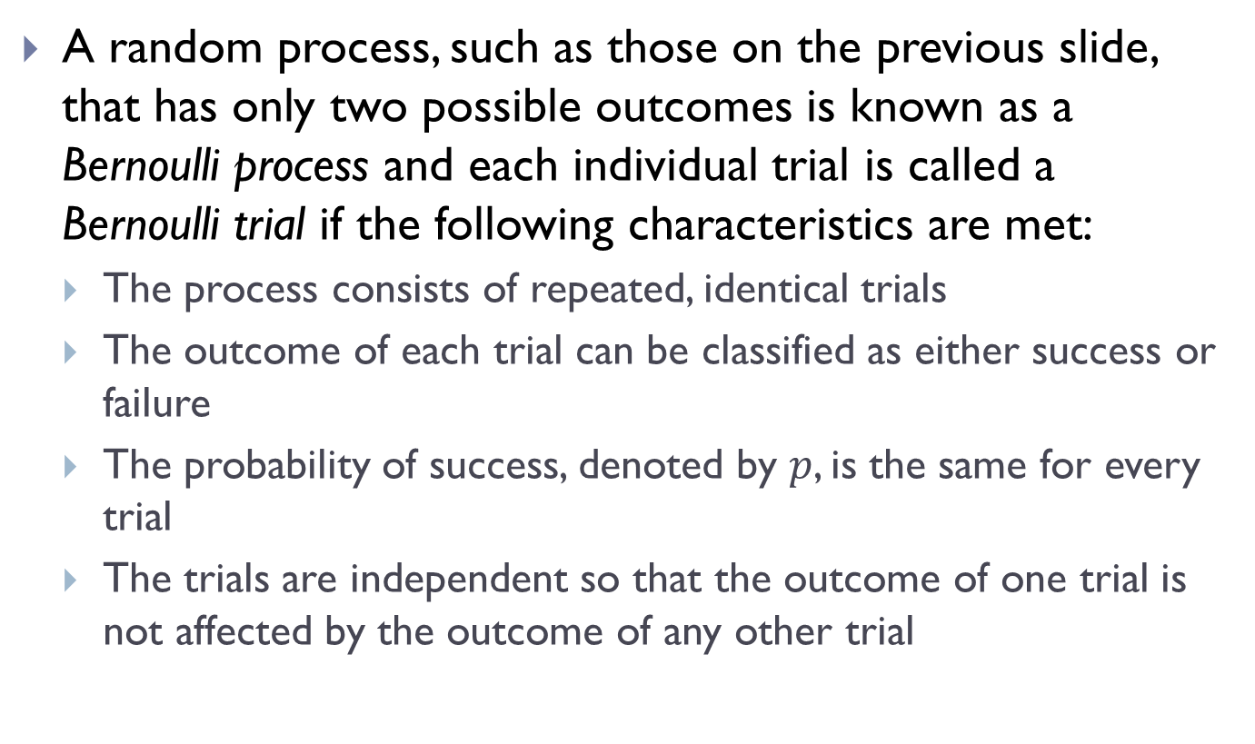
5.2 – Binomial and Multinomial
A random process, such as those on the previous slide, that has only two possible outcomes is known as a Bernoulli process and each individual trial is called a Bernoulli trial if the following characteristics are met:
  The process consists of repeated, identical trials
  The outcome of each trial can be classified as either success or failure
  The probability of success, denoted by $p$, is the same for every trial
  The trials are independent so that the outcome of one trial is not affected by the outcome of any other trial

Slide 6
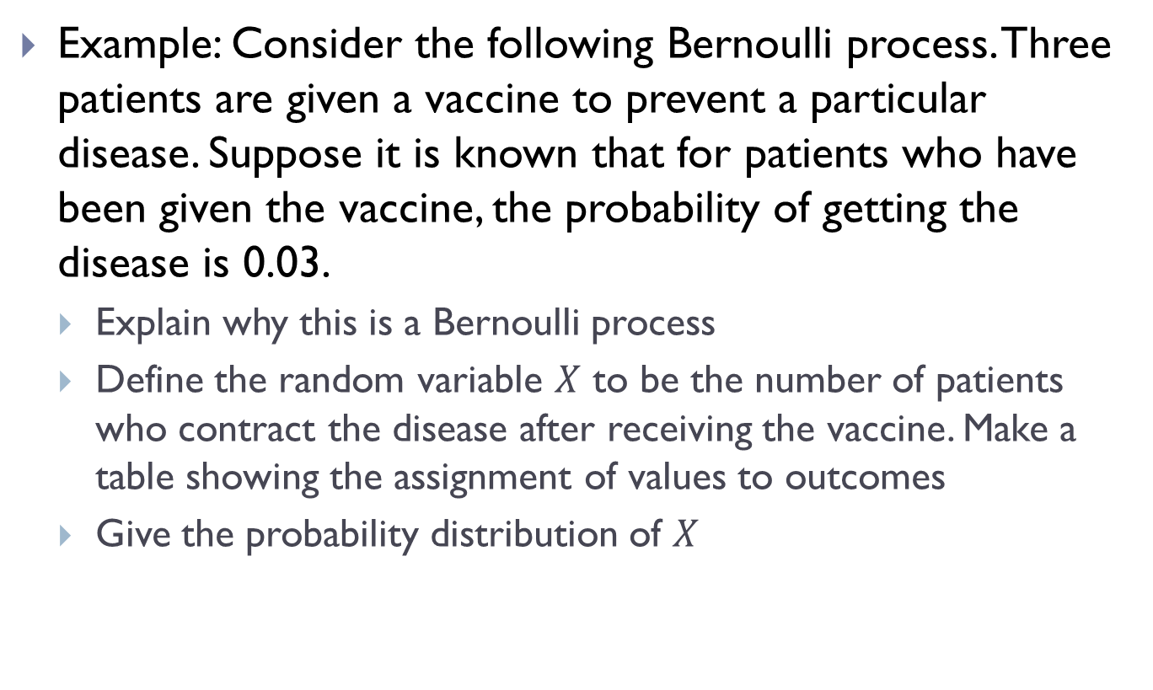
5.2 – Binomial and Multinomial
Example: Consider the following Bernoulli process. Three patients are given a vaccine to prevent a particular disease. Suppose it is known that for patients who have been given the vaccine, the probability of getting the disease is 0.03.
  Explain why this is a Bernoulli process
  Define the random variable $X$ to be the number of patients who contract the disease after receiving the vaccine. Make a table showing the assignment of values to outcomes
  Give the probability distribution of $X$

Slide 7
5.2 – Binomial and Multinomial
Each time a vaccine is given is a trial, so we have three trials here.
There are two outcomes for each individual: either they get the disease or they don’t.
  Note that we have defined getting the disease as a “success.”
The probability of getting a disease is constant for all three individuals.
While independence is rarely perfectly satisfied in real life, it is reasonable to assume that each of these three trials are independent.

Slide 8
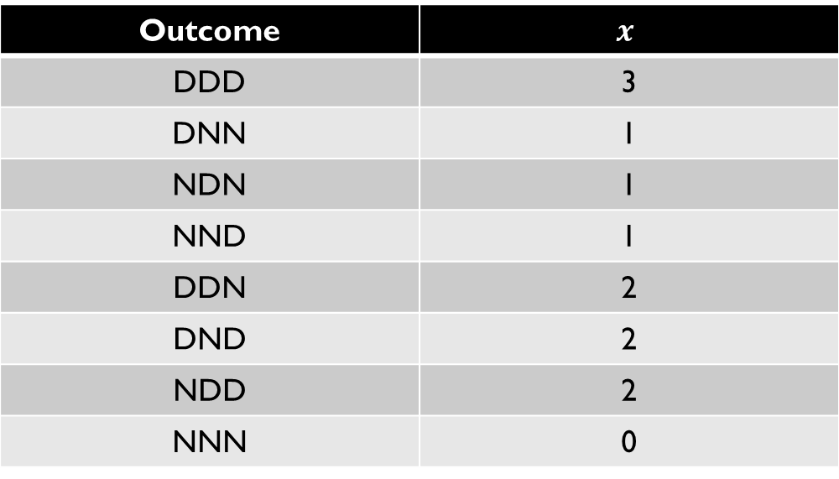

5.2 – Binomial and Multinomial
Using D as the event that a patient gets the disease and $N$ as the event that a patient does not get the disease, we have the following assignment of values to outcomes:
Outcome | $$x$$
DDD | 3
DNN | 1
NDN | 1
NND | 1
DDN | 2
DND | 2
NDD | 2
NNN | 0

Slide 9
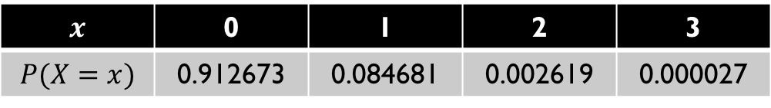
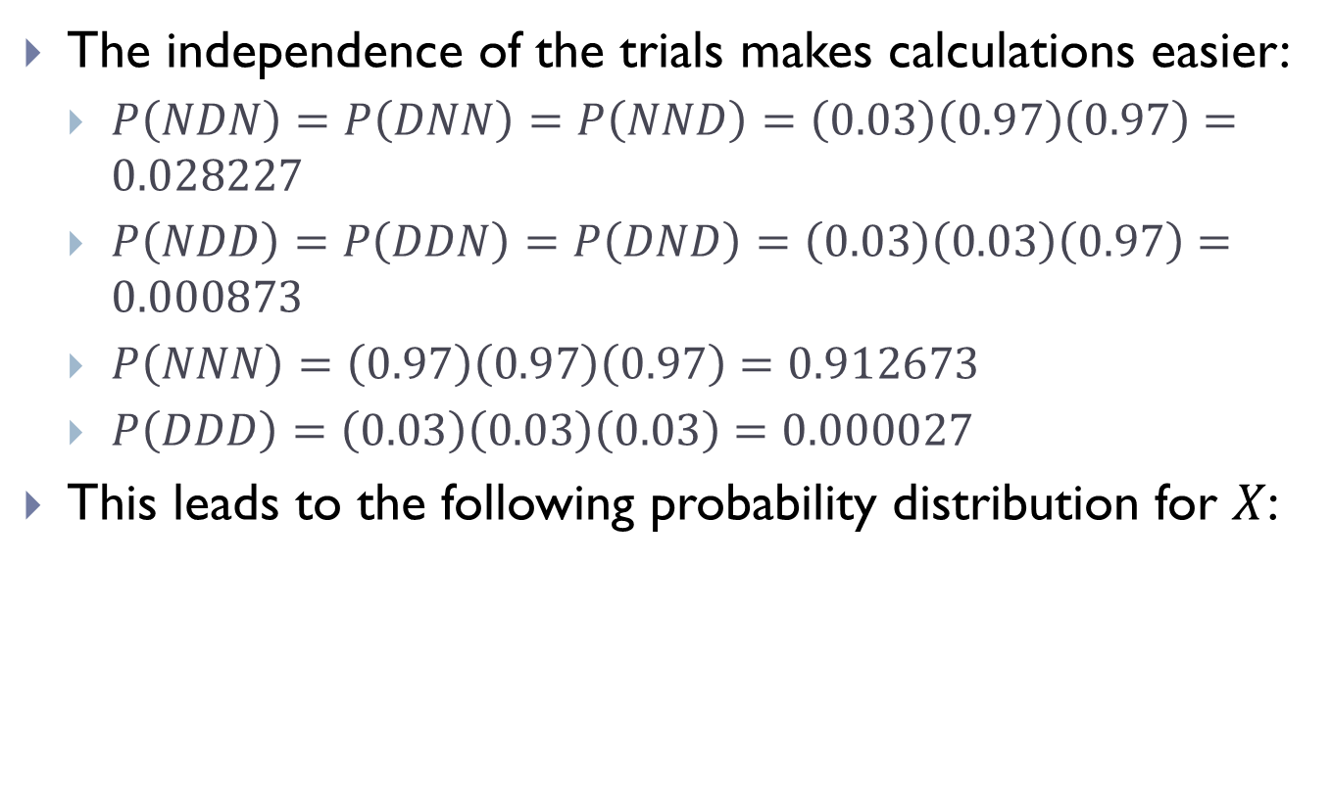
5.2 – Binomial and Multinomial
The independence of the trials makes calculations easier:
  $P\left(NDN\right)=P\left(DNN\right)=P\left(NND\right)=\left(0.03\right)\left(0.97\right)\left(0.97\right)=0.028227$
  $P\left(NDD\right)=P\left(DDN\right)=P\left(DND\right)=\left(0.03\right)\left(0.03\right)\left(0.97\right)=0.000873$
  $P\left(NNN\right)=\left(0.97\right)\left(0.97\right)\left(0.97\right)=0.912673$
  $P\left(DDD\right)=\left(0.03\right)\left(0.03\right)\left(0.03\right)=0.000027$
This leads to the following probability distribution for $X$:
$$x$$ | 0 | 1 | 2 | 3
$$P(X=x)$$ | 0.912673 | 0.084681 | 0.002619 | 0.000027

Slide 10
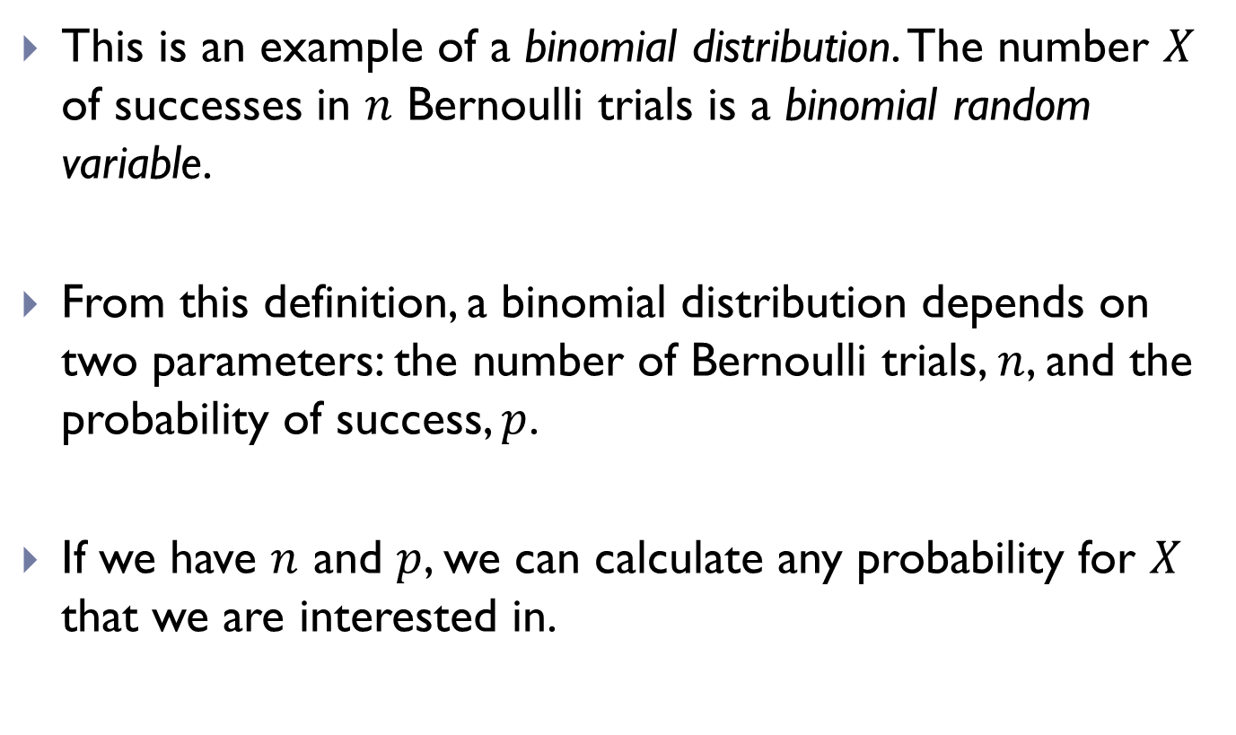
5.2 – Binomial and Multinomial
This is an example of a binomial distribution. The number $X$ of successes in $n$ Bernoulli trials is a binomial random variable.
From this definition, a binomial distribution depends on two parameters: the number of Bernoulli trials, $n$, and the probability of success, $p$.
If we have $n$ and $p$, we can calculate any probability for $X$ that we are interested in.

Slide 11
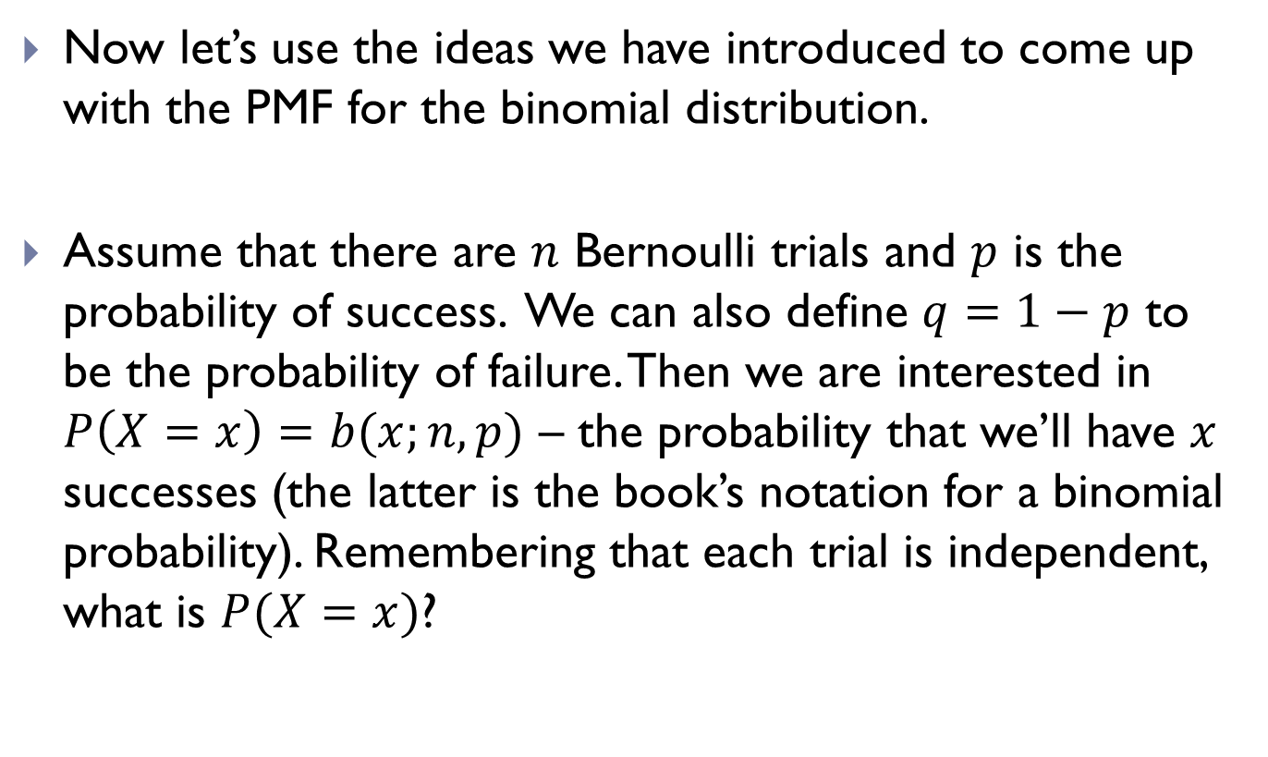
5.2 – Binomial and Multinomial
Now let’s use the ideas we have introduced to come up with the PMF for the binomial distribution.
Assume that there are $n$ Bernoulli trials and $p$ is the probability of success. We can also define $q=1−p$ to be the probability of failure. Then we are interested in $P\left(X=x\right)=b(x;n,p)$ – the probability that we’ll have $x$ successes (the latter is the book’s notation for a binomial probability). Remembering that each trial is independent, what is $P(X=x)$?

Slide 12
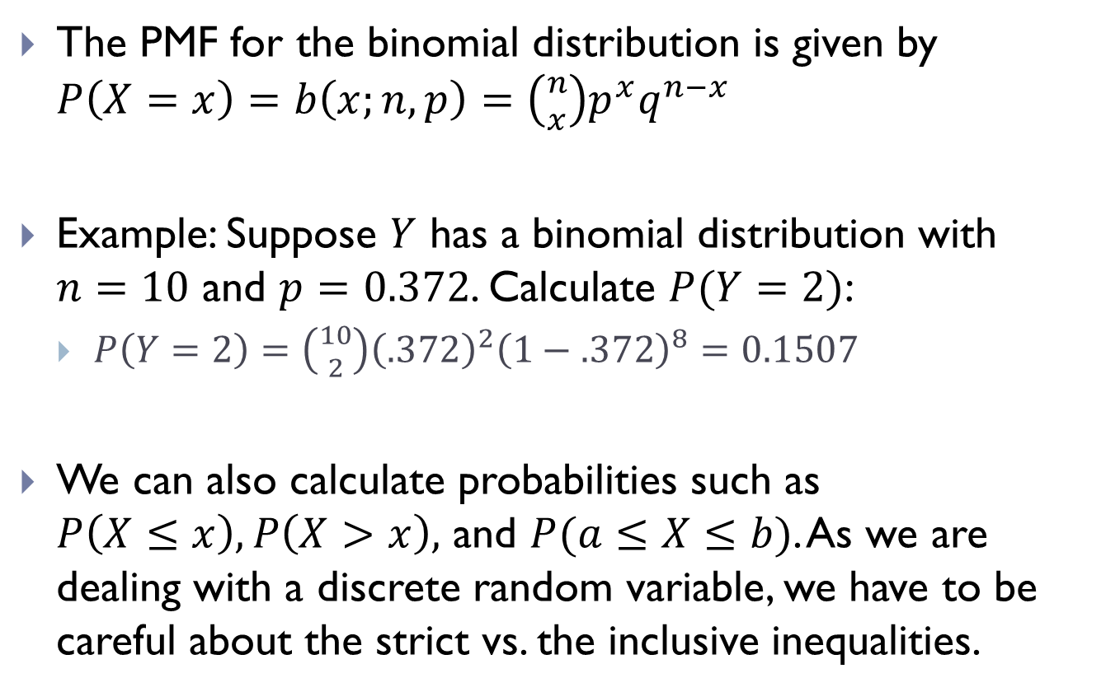
5.2 – Binomial and Multinomial
The PMF for the binomial distribution is given by $P\left(X=x\right)=b\left(x;n,p\right)=\left({n \atop x}\right)p^{x}q^{n−x}$
Example: Suppose $Y$ has a binomial distribution with $n=10$ and $p=0.372$. Calculate $P(Y=2)$:
  $P\left(Y=2\right)=\left({10 \atop 2}\right){\left(.372\right)}^{2}{\left(1−.372\right)}^{8}=0.1507$
We can also calculate probabilities such as $P\left(X≤x\right), P\left(X>x\right),$ and $P(a≤X≤b)$. As we are dealing with a discrete random variable, we have to be careful about the strict vs. the inclusive inequalities.

Slide 13
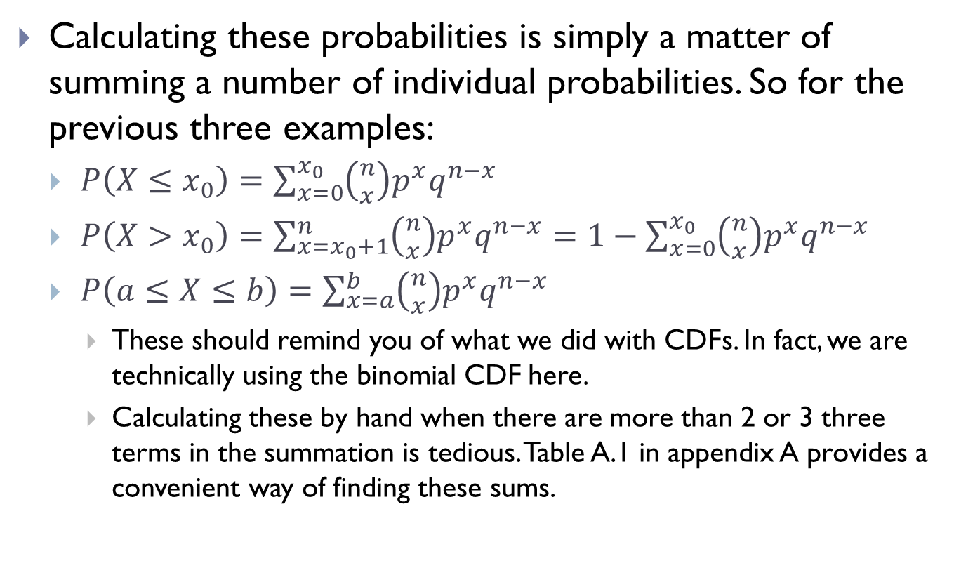
5.2 – Binomial and Multinomial
Calculating these probabilities is simply a matter of summing a number of individual probabilities. So for the previous three examples:
  $P\left(X≤x_{0}\right)=\sum_{x=0}^{x_{0}}{\left({n \atop x}\right)p^{x}q^{n−x}}$
  $P\left(X>x_{0}\right)=\sum_{x=x_{0}+1}^{n}{\left({n \atop x}\right)p^{x}q^{n−x}}=1−\sum_{x=0}^{x_{0}}{\left({n \atop x}\right)p^{x}q^{n−x}}$
  $P\left(a≤X≤b\right)=\sum_{x=a}^{b}{\left({n \atop x}\right)p^{x}q^{n−x}}$
    These should remind you of what we did with CDFs. In fact, we are technically using the binomial CDF here.
    Calculating these by hand when there are more than 2 or 3 three terms in the summation is tedious. Table A.1 in appendix A provides a convenient way of finding these sums.

Slide 14
5.2 – Binomial and Multinomial
Exercise: The probability that a patient recovers from a certain infection is 0.4. For a group of 15 patients, use table A.1 or the app to find the probability that:
  At least 10 recover
  Between 3 and 8 recover
  Exactly 5 recover

Slide 15
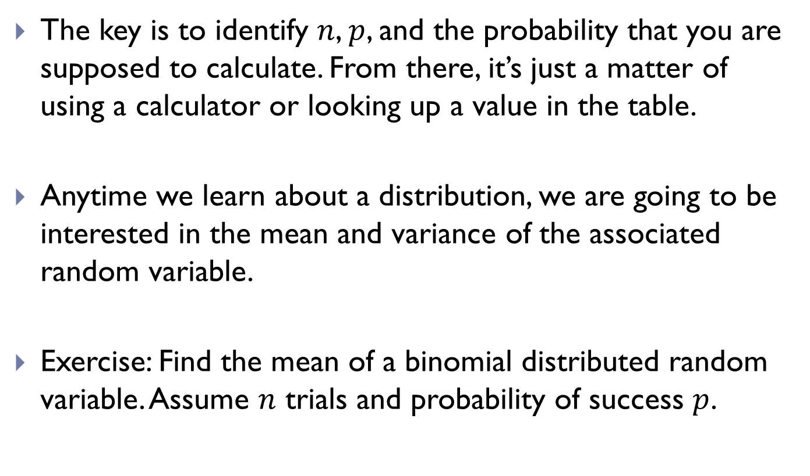
5.2 – Binomial and Multinomial
The key is to identify $n$, $p$, and the probability that you are supposed to calculate. From there, it’s just a matter of using a calculator or looking up a value in the table.
Anytime we learn about a distribution, we are going to be interested in the mean and variance of the associated random variable.
Exercise: Find the mean of a binomial distributed random variable. Assume $n$ trials and probability of success $p$.

Slide 16
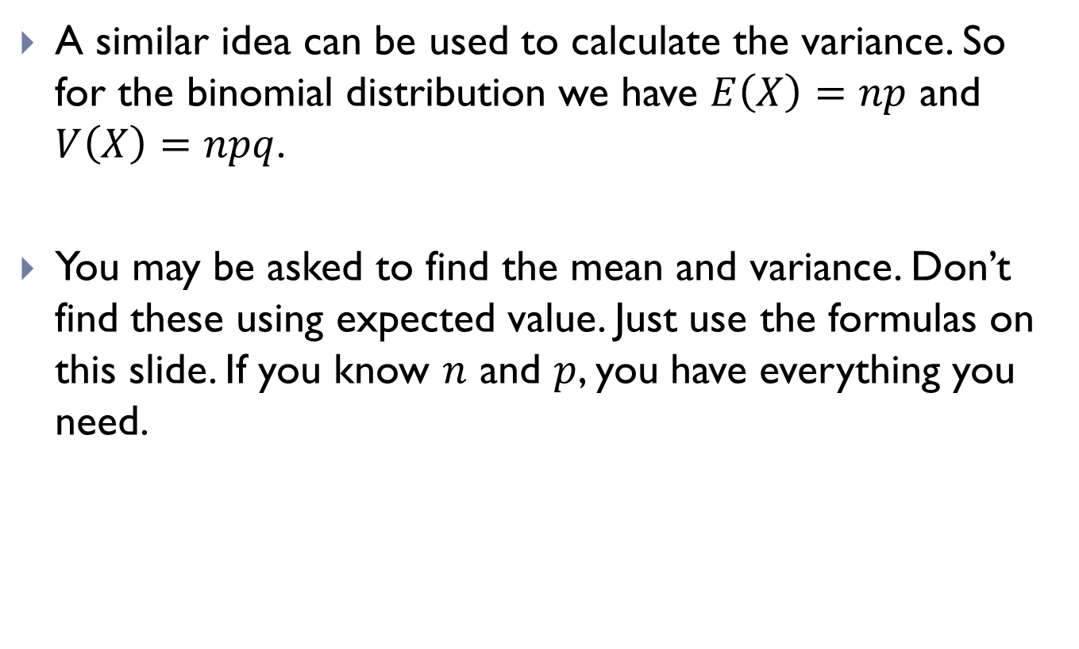
5.2 – Binomial and Multinomial
A similar idea can be used to calculate the variance. So for the binomial distribution we have $E\left(X\right)=np$ and $V\left(X\right)=npq$.
You may be asked to find the mean and variance. Don’t find these using expected value. Just use the formulas on this slide. If you know $n$ and $p$, you have everything you need.

Slide 17
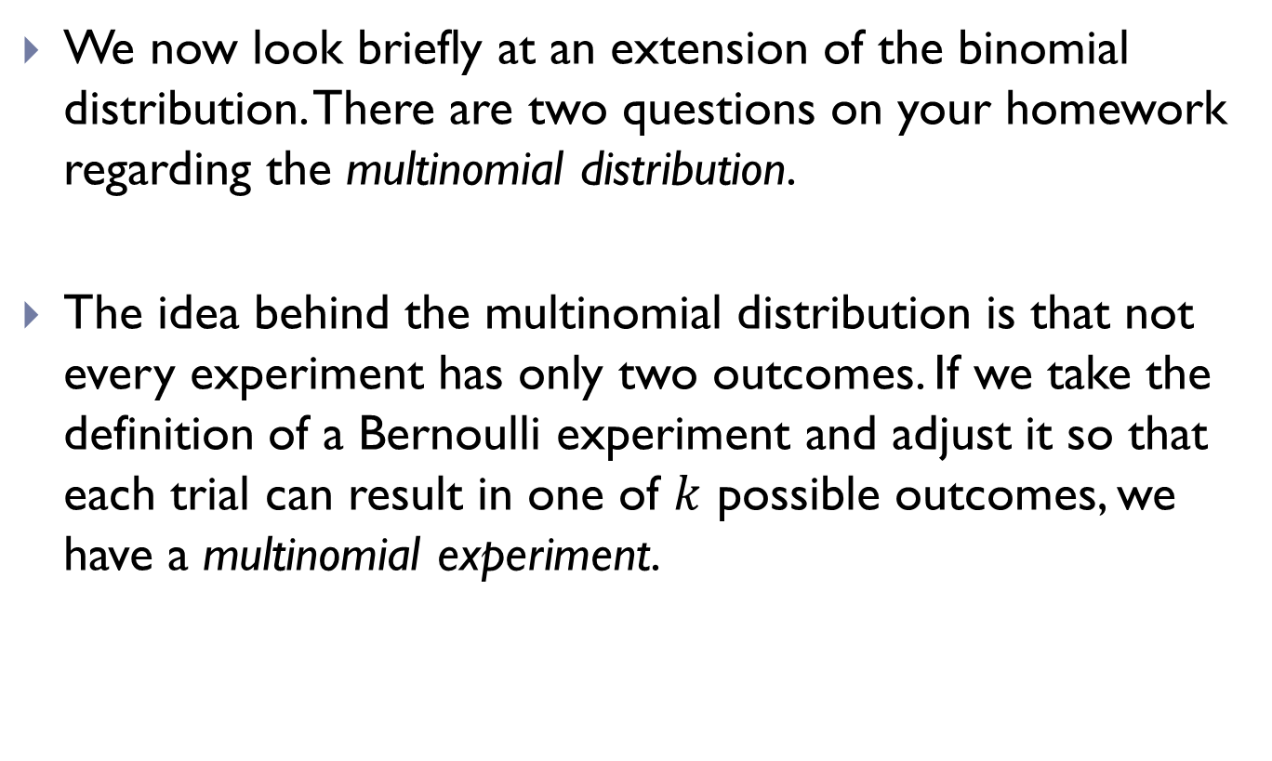
5.2 – Binomial and Multinomial
We now look briefly at an extension of the binomial distribution. There are two questions on your homework regarding the multinomial distribution.
The idea behind the multinomial distribution is that not every experiment has only two outcomes. If we take the definition of a Bernoulli experiment and adjust it so that each trial can result in one of $k$ possible outcomes, we have a multinomial experiment.

Slide 18
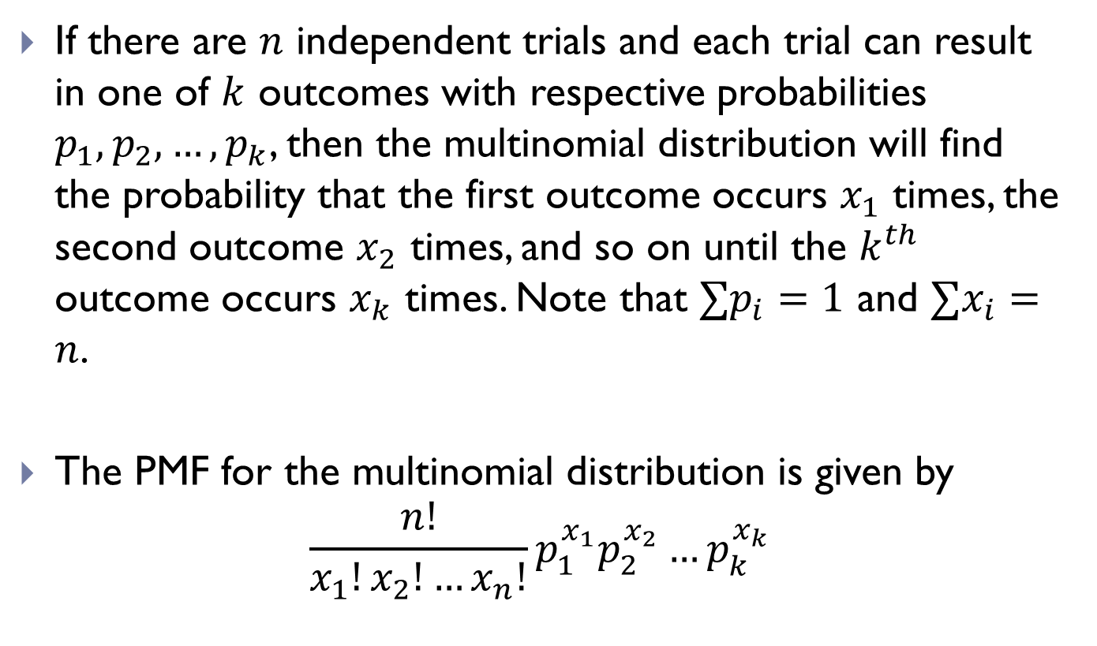
5.2 – Binomial and Multinomial
If there are $n$ independent trials and each trial can result in one of $k$ outcomes with respective probabilities $p_{1},p_{2},…,p_{k}$, then the multinomial distribution will find the probability that the first outcome occurs $x_{1}$ times, the second outcome $x_{2}$ times, and so on until the $k^{th}$ outcome occurs $x_{k}$ times. Note that $∑p_{i}=1$ and $∑x_{i}=n$.
The PMF for the multinomial distribution is given by
$$\frac{n!}{x_{1}!x_{2}!…x_{n}!}p_{1}^{x_{1}}p_{2}^{x_{2}}…p_{k}^{x_{k}}$$

Slide 19
5.2 – Binomial and Multinomial
Example: Suppose a certain candy comes in five different colors: red, green, blue, orange, and yellow. It is known that these colors occur with frequency 0.4, 0.2, 0.2, 0.1, and 0.1, respectively. In a random sample of 20 candies, what is the probability that we will have four of each color?

Slide 20
5.5 - Poisson
We now move on from binomial and multinomial to look at a different discrete distribution.
Experiments that yield a number of outcomes in a given time interval or in a specified region are called Poisson experiments. Note that any time interval or any specified region can be used.
The Poisson process is named for the French mathematician Simeon Poisson. But the word Poisson means “fish” in French. Because of this, the classic example of a Poisson process is the number of fish caught in an hour.

Slide 21
5.5 - Poisson
Other examples:
  Quality control (number of flaws in a manufacturing process, number of defective products in a shipment)
  Ecology (number of plant species present in a certain area)
  Entomology (number of eggs eaten by a beetle in an hour)
  Epidemiology (number of cases of a disease per 100,000 people)
  Sales (number of customers that will purchase a particular item in a month)

Slide 22
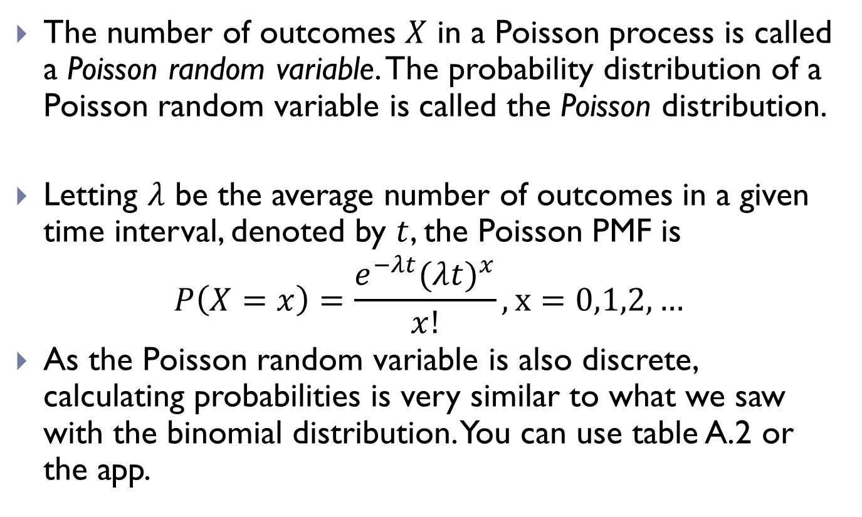
5.5 - Poisson
The number of outcomes $X$ in a Poisson process is called a Poisson random variable. The probability distribution of a Poisson random variable is called the Poisson distribution.
Letting $λ$ be the average number of outcomes in a given time interval, denoted by $t$, the Poisson PMF is
$$P\left(X=x\right)=\frac{e^{−λt}(λ{t)}^{x}}{x!}, x=0,1,2,…$$
As the Poisson random variable is also discrete, calculating probabilities is very similar to what we saw with the binomial distribution. You can use table A.2 or the app.

Slide 23
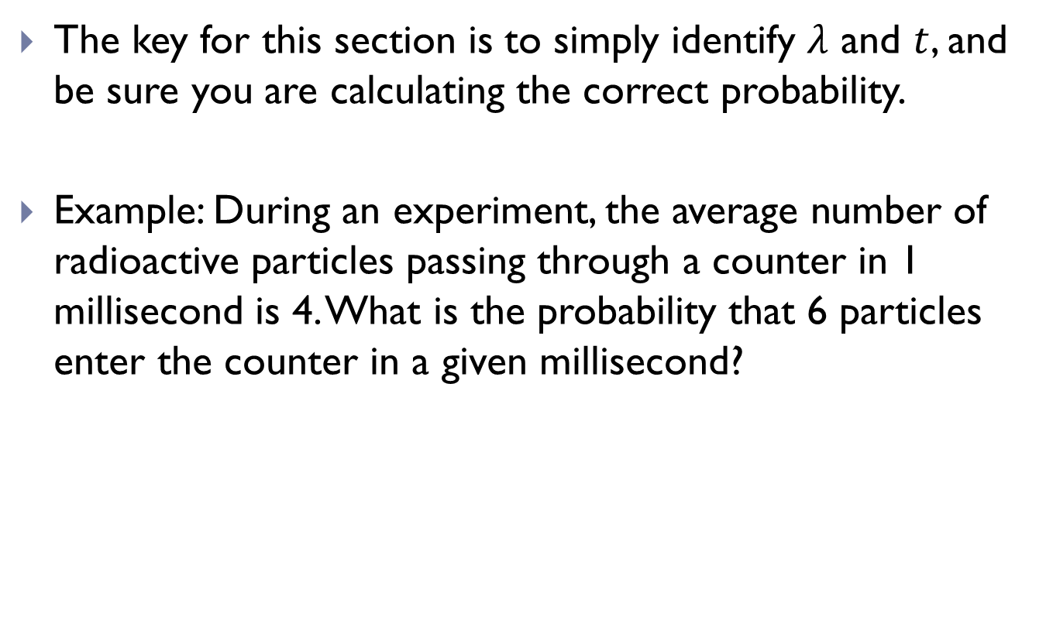
5.5 - Poisson
The key for this section is to simply identify $λ$ and $t$, and be sure you are calculating the correct probability.
Example: During an experiment, the average number of radioactive particles passing through a counter in 1 millisecond is 4. What is the probability that 6 particles enter the counter in a given millisecond?

Slide 24
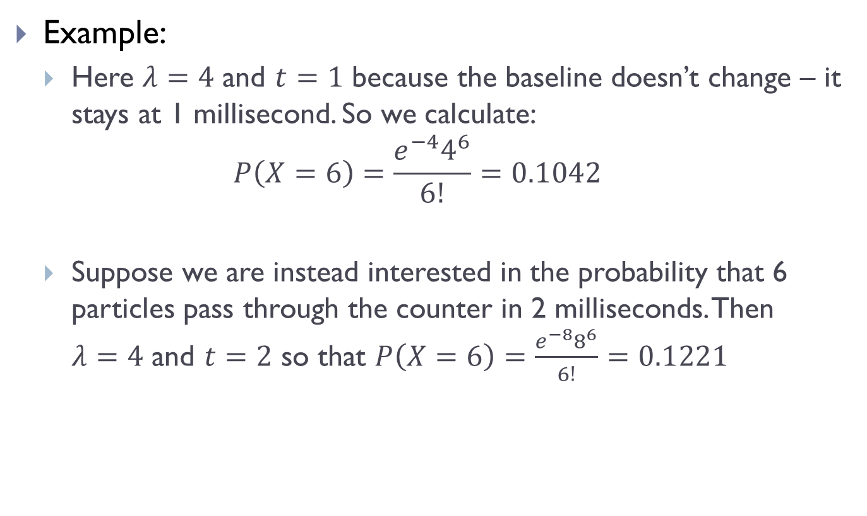
5.5 - Poisson
Example:
  Here $λ=4$ and $t=1$ because the baseline doesn’t change – it stays at 1 millisecond. So we calculate:
  $$P\left(X=6\right)=\frac{e^{−4}4^{6}}{6!}=0.1042$$
  Suppose we are instead interested in the probability that 6 particles pass through the counter in 2 milliseconds. Then $λ=4$ and $t=2$ so that $P\left(X=6\right)=\frac{e^{−8}8^{6}}{6!}=0.1221$

Slide 25
5.5 - Poisson
We are again interested in formulas for the mean and variance of a Poisson random variable.
Exercise: Find the mean and variance for a Poisson random variable.

Slide 26
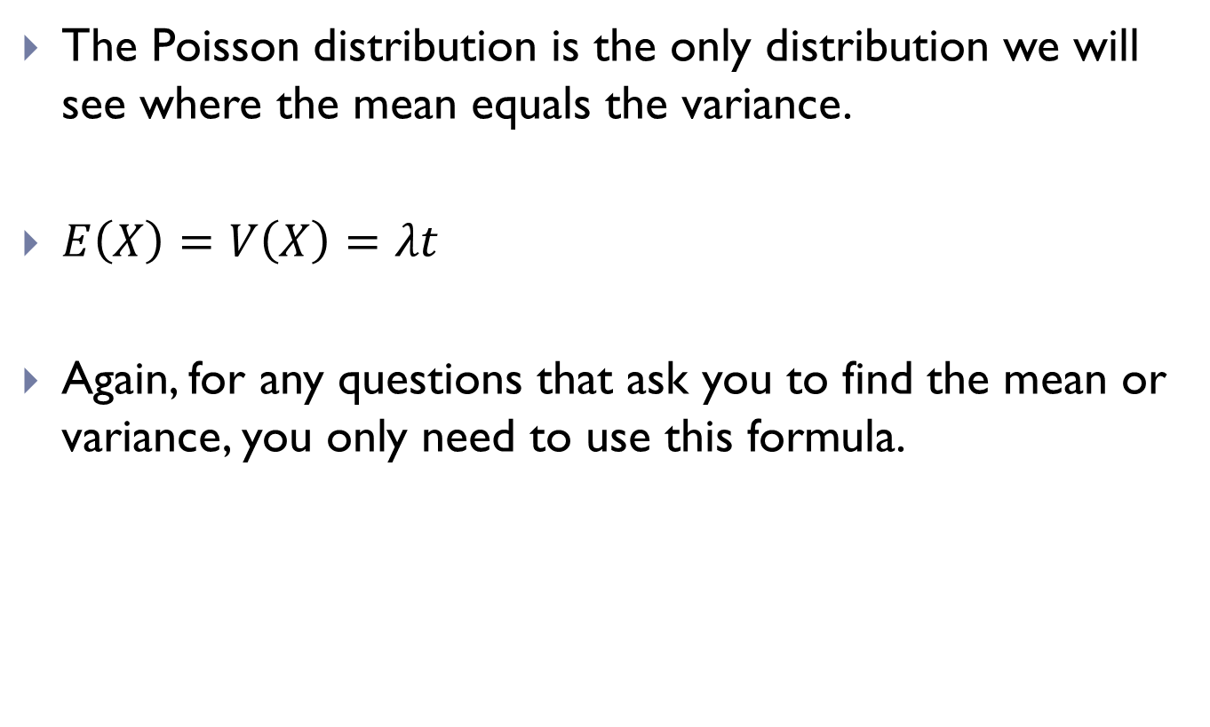
5.5 - Poisson
The Poisson distribution is the only distribution we will see where the mean equals the variance.
$E\left(X\right)=V\left(X\right)=λt$
Again, for any questions that ask you to find the mean or variance, you only need to use this formula.

Slide 27
5.5 - Poisson
Exercise: Suppose the number of cases of a certain disease reported in a year follows a Poisson distribution with mean 2.5. Find the probability that:
  No cases are reported in a given year
  Exactly three cases are reported in a year
  At least three cases are reported in a year
  At most three cases are reported in a year
  Between 2 and 5 cases are reported in 6 months

